Slide 1
Budget Perspectives 2025
DATE
13th June 2024
VENUE
ESRI, Whitaker Square, Sir John Rogerson's Quay,
Dublin 2

Slide 2
The Distributional Impact of Carbon Pricing and Energy Related Taxation in Ireland
Ninth Meeting of the Society for the Study of Economic Inequality
July 8-10, 2021
Cathal O’Donoghue (University of Galway)
Herwig Immervoll (OECD)
Zeynep Gizem Can (Adana Alparslan Türkeş Science & Technology University)
Assia Elgouacem (OECD)
Jules Linden (University of Galway, (LISER)
Anasuya Raj (OECD)
Denisa Sologon (LISER)

Slide 3
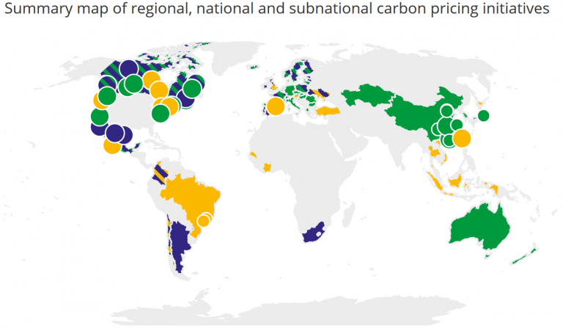
Context
Carbon tax/pricing under development
Many OECD countries have or are considering the use of Carbon tax/ pricing to disincentivise cabon emissions
Pro-poor Environmental Policy - Pricing carbon will involve fewer social, economic and environmental trade-offs if it is accompanied by measures that ensure affordable access to cleaner alternatives.
Ireland was an early adopter of Carbon Taxation
Spatial
Green: ETS implemented or scheduled Yellow: Considered an ETS or carbon tax Blue: Carbon tax implemented or scheduled Green / Yellow : ETS implemented, carbon tax under consideration Blue: Yellow : Carbon tax implemented or scheduled, ETS considered
Source https://www.ciat.org/ciatblog-taller-de-la-onu-sobre-impuestos-al-carbono-parte-1-en-paises-en-desarrollo/?lang=en

Slide 4
Context
Distributional nature of Carbon Emissions depends upon the nature of emissions consumed
Type of fuel consumption
Type of food consumption
Both direct and indirect sources of emissions
Location of greenhouse gas emissions across the income distribution
Price and influence of taxation on existing fuels and interaction with other instruments
Heating fuels typically have lower taxation and/or higher subsidies than transport fuels
Heating fuels sometimes have higher emissions (solid fuels)
Poor often more likely to spend on heating fuels

Slide 5
Theoretical Issues – Carbon Pricing
Short-term and Long-term price elasticity Issues – impact capacity of
Capacity to invest in cheaper energy rather than just reduce emissions may increase fuel poverty – how to enable change in the short run and the long run?
Use of Revenue often most important distributional impact
Double Dividend Replacement of more distortionary taxation can improve efficiency – however difficult to minimise both distributional impact and reduce distortions

Slide 6
Existing Knowledge in Ireland
Early work → Scott (1992) direct distributional incidence of carbon taxes,
O’Donoghue (1997) both the direct and indirect incidence →vertical redistribution: regressive nature of a theoretical carbon tax but with a flatter indirect component.
Verde and Tol (2009) →regressive nature of a theoretical carbon tax on households with lower energy efficiency,
Callan et al. (2009) considered the net impact of a tax with revenue recycling.
Farrell (2017) → horizontal redistributional characteristics of the tax, with socio-economic characteristics being an important driver of carbon taxes.
De Bruin & Yakut (2019, 2023) explored the general equilibrium effects of the actual carbon tax
Reaños et al. (2022) → distributional impact of actual carbon tax with sophisticated demand system,
Reaños et al. (2023) → net benefit of reduced carbon emissions.
Linden et al. (2024) →comparative exercise across Europe

Slide 7
OECD Effective Carbon Rates
OECD produce an analysis of Effective Carbon Rates every three years – with a focus primarily on carbon generated from Energy
“Carbon pricing very effectively encourages the shift of production and consumption choices towards low and zero carbon options that is required to limit climate change.
The "carbon pricing score" measures how close the 44 countries, together as well as individually, are to the goal of pricing all energy related carbon emissions at current and forward-looking benchmark values for carbon costs.”
Forthcoming Chapter in OECD Employment Outlook in 2024

Slide 8
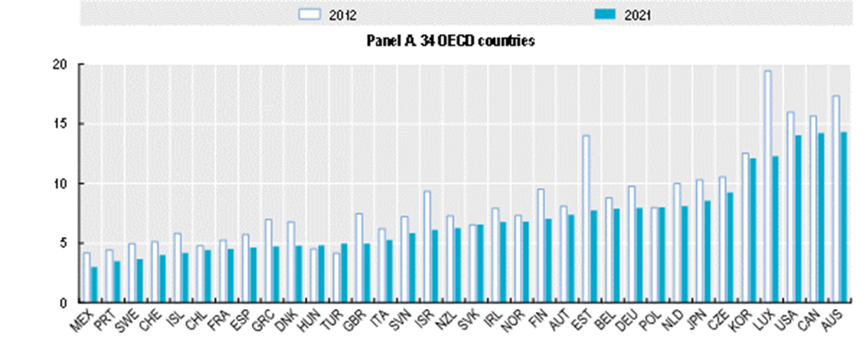
Carbon emissions from energy use in OECD countries (tonnes of CO2 per capita, 2012 and 2021)
Ireland is mid ranked with slight decline 2012→2021

Slide 9
Types of Carbon Price
Different Sources of Carbon Prices
Emissions Trading
Carbon Taxes
Fuel Excise Tax – although not based upon carbon, they are proportional to the volume of fuel used
Also indirectly VAT as these instruments are typically vateable

Slide 10
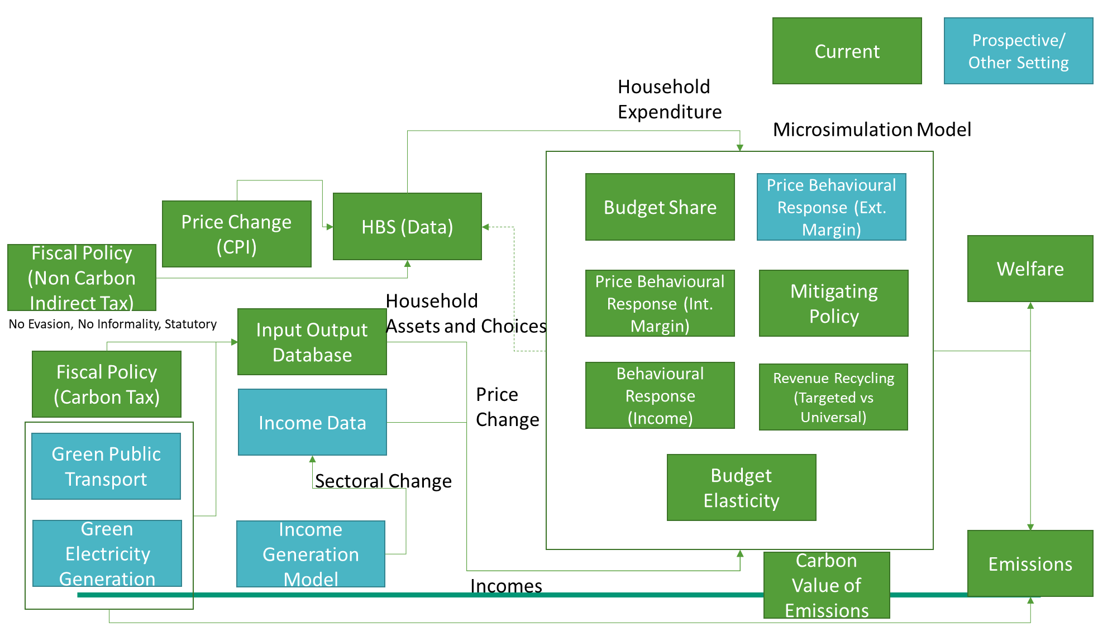
Core Purpose of Microsimulation Models
Understand and Manage Complexity
Method – PRICES Microsimulation Model
Micro-Simulation
Analysis at Micro Level
Ex Ante Simulate Policy
Helps in
Policy x Population x Behaviour
Methodology in recent OUP Book
Model links
Input-Output table
Household Budget Survey
Behavioural Change – Demand System
Policy Simulation Models
Spatial

Slide 11
Distribution of Energy Expenditure
Fuel Expenditure by Source as % Expenditure (ranked by emissions)
Expressed as a share of income higher energy expenditure share at bottom of distribution
Driven by
motor fuels and electricity
home heating fuels to a lesser degree

Slide 12
Carbon Emissions per households (ranked by income)
Distribution of Carbon Emissions
Absolute household emissions – rise with income
Fall as a % of income
Inequality in energy use
Direct emissions (emissions from household use of energy → by far the most important
Followed by the energy used in purchased domestic goods and services
Followed by the energy used in imported goods and services

Slide 13
Household Characteristics
Household Characteristics (ranked by equivalised emissions) 90:10 Decile Ratio
Ranking by tCO2 as a share of income and
Expressing decile value as ratio to mean of population
If no difference by population group – flat distribution
Important differences between household types
Pensioners and rural households are more likely to be in the top of the distribution of emissions intensity

Slide 14
Household Characteristics
Household Characteristics (ranked by equivalised emissions) 90:10 Decile Ratio
Richer households are more likely to have lower emissions intensities (but higher total emissions)
Therefore households with higher education, more earners, male headed and higher income households have lower than average shares with the highest intensities

Slide 15
Distribution of Carbon Price Instruments 2021
Carbon Price Instruments in 2021 as % of income (ranked by income decile)
Carbon Price Instruments divided into
3 Instruments Excise Duties, Carbon Taxes, ETS
2 Dimensions – Direct Energy Use; Energy used in other goods and services
2021
Generally declining as share of income, (but relatively flat as share of expenditure)
Importance of Savings – higher savings rate at the top of distribution
Direct Excise Duties
Others similar importance
However this will change as CT and ETS grow relative to Excise Duties

Slide 16
Distribution of Carbon Price Instruments
Change in Carbon Price 2012-21 Instruments as % of income (ranked by income decile) Deflated by CPI
Increase in carbon pricing in real terms since 2012
However Excise Duties have fallen in real terms as a % of income
Indirect ETS and CT most important followed by Direct CT

Slide 17
Growth in Carbon Pricing relative to growth in Wages or other Prices
Distribution of Losers (ranked by income decile)
Carbon pricing has grown faster than CPI and the labour cost growth in all sectors between 2012 and 2021.
Post 2021 – likely to be different story
However to have an impact on behaviour carbon pricing should have to grow faster than income growth
DPER carbon tax rates although increasing due to higher damage costs have not been adjusted for price or wage growth

Slide 18
Distribution of Winners and Losers with Full Revenue Recycling
Distribution of Winners (ranked by income decile)
Policy scenario – convert change in revenue generated into lump sum payment
Winner concentrated at bottom

Slide 19
Distribution of Winners and Losers with Full Revenue Recycling
Distribution of Losers (ranked by income decile)
As one varies the lump sum transfer from 0 to 100% of the revenue generated, the share of winners grows.
With a flat transfer – perhaps equivalent to general expenditure, the share of winners does not exceed the share of losers until quite a high (> 80%) of revenue is distributed

Slide 20
Distribution of Winners and Losers by Type of Targeting
Distribution of Winners (ranked by Revenue Recycling Share)
Considering different options with different types of targeting the nature of the winners and losers change
In terms of redistribution, how one spends the revenue is more important than the carbon pricing

Slide 21
Conclusions and Take Home Message
Distributional Impact: Differences across distribution
Declining budget shares as percentage of income – however higher emissions for higher incomes
Mainly regressive carbon prices →Quite different strategies in terms of instruments
Quite big differences by type of household -
Mitigation
Hard to achieve both reductions in distortions and to protect losers
Revenue recycling differs by type of revenue recyclingn
Science developing on distributional impact of environmental policy – need for greater integration between tax, environmental and social policy – akin to earlier work on the integration of taxes and benefits
Promo → Session @ International Microsimulation Association June 2025

Slide 22
Thank you Cathal.odonoghue@universityofgalwayie

